Slide 1
Finite State Machines
CSS 343: Data Structures, Algorithms, and Discrete Mathematics II
Version 2
Wooyoung Kim

Slide 2

Regular expression-review
Regular expression over the alphabet ∑ (defined recursively)
Empty string λ
Any character in ∑
Given X and Y are regular expressions, so are
X* means zero or more repetitions of X
Examples
∑ = {+, -, 0, 1}
L1 = {S| S is an unsigned binary number}:
L2 = {S| S is a signed binary number}:
Allow positive numbers with implied sign
| or U
(0|1)(0|1)*
(-|λ)(0|1)(0|1)*

Slide 3
Finite-State Machine
Finite-state machine example
Set of (finite) states (one starting state, set of final states, and/or others) : ex: on, off
Input alphabet (action) : ex {down, up}
Transition function (given a state and an input, knows a state to move to)
Ex) f(on, down) = off
f(off, up) = on
States | Transition
input | Down | Up
On | Off | Off
Off | Off | On
down
up
On
Off
down
up

Slide 4
Finite-State Machine
Finite-state machine with output
Set of (finite) states (one starting state, set of final states, and/or others)
Input alphabet
Output alphabet
Output function
Transition function (given a state and an input, knows a state to move to)
0/0
1/1
start
S1
1/0
S2
States | Output, Transition
input | 0 | 1
S1 | 0, S1 | 0, S2
S2 | 0, S3 | 1, S2
S3 | 1, S1 | 0, S2
0/1
0/0
1/0
S3

Slide 5
Finite-State Machine
Finite-state machine without output
Set of (finite) states (one starting state, set of final states, and/or others)
Input alphabet
Transition function (given a state and an input, knows a state to move to)
0
1
start
S1
1
S2
States | Transition
input | 0 | 1
S1 | S1 | S2
S2 | S3 | S2
S3 | S1 | S2
0
0
1
S3

Slide 6
DFA and NFA
Automata: a machine that takes as input a set of coded instruction and outputs a range of predetermined responses according to different circumstances.
Finite-state automata
A finite state machine that accepts or rejects strings of a language which it defines
Deterministic finite automata (DFA): given a state, have a transaction for every input character (i.e., for every state and every alphabet symbol there is exactly one move that the machine can make)
Cf) Non-Deterministic finite automata (NFA): there can be zero or more state transitions for every input-state pair. DFA is part of NFA

Slide 7

FAs and language
Recognized string: when all its characters are processed, it ends in one of the final states (double circles: accepting state)
Kleene’s theorem: every regular language can be defined by regular expression & finite automata

Slide 8
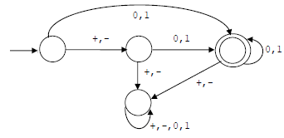
Note for NFA and DFA
Kleene’s theorem: every regular language can be defined by regular expression & finite automata
Here, the finite automata is generally NFA. However, for any language recognized by a NFA, there is a DFA to recognize the same language
According to Kleene’s theorem, any regular expression can be converted to NFA, meaning, we can also find a DFA recognizing the language
Therefore, if we can build a finite automata for a language, then it is regular. If we cannot make a finite automata, then it is not a regular

Slide 9
Examples
What can be recognized by these Finite Automata?
Recognized string: when all its characters are processed, it ends in one of the final states
Find an FA for the following language
∑ = {a, b, 2, 3, _}, identifiers in C++ like language
start with letter or underscore followed by any characters

Slide 10
Examples
What can be recognized by these Finite Automata?
Recognized string: when all its characters are processed, it ends in one of the final states
Find an FA for the following language
∑ = {a, b, 2, 3, _}, identifiers in C++ like language
start with letter or underscore followed by any characters (including empty)
(0|1)(0|1)*
(+|-| λ)(0|1)(0|1)*
start
a, b, _
a, b, 2,3, _
2,3
a, b, 2,3, _

Slide 11
Language to FA
Determine all possible cases as states
Set the target state as ending state
Non target states are trap states
Determine the transitions

Slide 12
Language to FA
FAs for language (may give state a name/meaning if possible)
∑ = {a, b}, all words contain even number of a’s and even number of b’s
∑ = {a, b, c}, all words do not contain the substring “ab”

Slide 13
Language to FA
FAs for language (may give state a name/meaning if possible)
∑ = {a, b}, all words contain even number of a’s and even number of b’s
∑ = {a, b, c}, all words do not contain the substring “ab”
start
a
ee
a
oe
b
b
b
b
a
eo
oo
a
b,c
a
a,b,c
start
a
b
State without immediate ‘a’
State with immediate ‘a’
Trap state
c

Slide 14
Practice
∑ = {a, b}
All words contain odd number of a’s (i.e., L4 = {S| S has an odd number of a’s})
Let ∑ = {0,1}, draw a DFA for the language of all strings not containing 101 as a substring.
How about a^{n}b^{n}, n >= 0 ?
Not a regular language! No DFA
Can be modeled by context free (CF) gramma
More practice: Rosen book Chapter 13.3 Exercise 23-36

Slide 15
Practice
∑ = {a, b}
All words contain odd number of a’s (i.e., L4 = {S| S has an odd number of a’s})
Let ∑ = {0,1}, draw a DFA for the language of all strings not containing 101 as a substring.
How about a^{n}b^{n}, n >= 0 ?
Not a regular language! No DFA
Can be modeled by context free (CF) gramma
b
b
start
a
a
0
1
0,1
start
1
0
1
Trap state
0

Slide 16
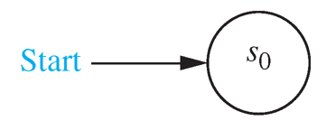
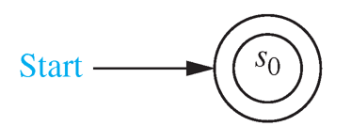
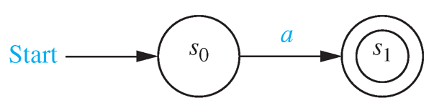
Regular expression and FSA
Empty set
λ:Empty string
{a}
ab
a|b
a*
a
b
a
b
a

Slide 17
(D)FA → regular expression
Sometimes, building DFA is easier than obtaining RE
One possible approach: remove state one at a time (optional reading)

Slide 18
(D)FA → RE
Make S0 as non-accepting and no transitions in.
Add a new non-accepting S0 and add λ
Replace ε to λ

Slide 19
(D)FA → RE
Make as a single accepting state: Multiple accepting states, or a single accepting state with transitions out can transit to one accepting state (add λ).
Replace ε to λ

Slide 20
(D)FA → RE
3. Eliminate other states in any order except start and accepting states (See the DFA_to_RE.pdf)
Replace ε to λ

Slide 21
(D)FA → RE
Replace ε to λ

Slide 22
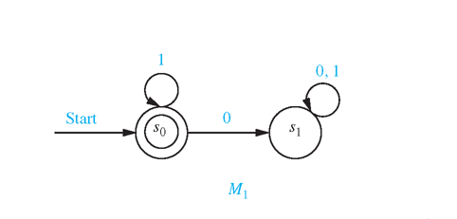
Example (1)
1. Add one for start 2. Remove S₁
λ
Regular expression is
1*

Slide 23
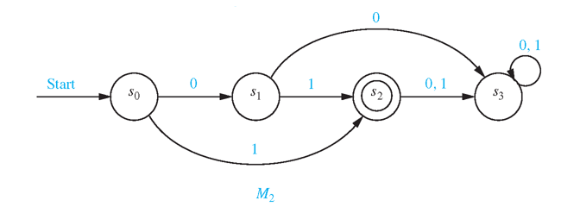
Example (2)
1. Since S₂ is accepting with transitions out, make new accepting state
S₂
λ

Slide 24
2. Remove S₃ :There is no returning transitions to S₂
S₂
λ
3. Remove S₁ : S₀ goes to S₂ on 1 or 01
S₂
λ
1 | 01
4. Remove S₂ : S₀ goes to the new accepting state (1|01) λ => 1 | 01
1 | 0 1
(1 | 01) λ

Slide 25
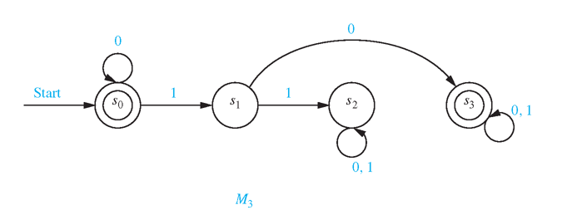
Example (3)
Add one for start
Add one accepting state
λ
λ
λ

Slide 26
3. Remove S2
λ
λ
λ
4. Remove S1, and concatenate the transition
λ
1 0
λ
λ

Slide 27
5. Remove S3 and concatenate the transitions
λ
1 0 (0|1)*
λ
λ
6. Remove S0, and concatenate the transitions
λ
0* | 0* 1 0 (0 | 1)*
0*1 0 (0|1)*
λ
0*λ
λ

Slide 28
More examples
start
a, b, _
a, b, 2,3, _
2,3
a, b, 2,3, _

Slide 29
More examples
(0|1)(0|1)*
(+|-| λ)(0|1)(0|1)*
start
a, b, _
a, b, 2,3, _
2,3
(a|b|_)(a|b|2|3|_)*
a, b, 2,3, _

Slide 30
L(G)→DFA→RE
Example 1

Slide 31
L(G)→DFA→RE
∑ = {a, b, c, 1,2 3,_},
Ada program identifiers which are restricted from having consecutive underscore characters and must start with a letter

Slide 32
L(G)→DFA→RE
∑ = {a, b, c, 1,2 3,_},
Ada program identifiers which are restricted from having consecutive underscore characters and must start with a letter
start
a, b, c
a, b, c, 1,2,3
S1
S2
1, 2,3, _
_
a, b, c, 1,2,3
_
S4
S3
a, b, c,1, 2,3, _

Slide 33
L(G)→DFA→RE
∑ = {a, b, c, 1,2 3,_},
Ada program identifiers which are restricted from having consecutive underscore characters and must start with a letter
a, b, c, 1,2,3
start
a, b, c
S1
S2
λ
1, 2,3, _
_
a, b, c, 1,2,3
S5
_
S3
λ
S4
a, b, c,1, 2,3, _
Since it has 2 accepting states, add a single accepting state (S5).

Slide 34
L(G)→DFA→RE
∑ = {a, b, c, 1,2 3,_},
Ada program identifiers which are restricted from having consecutive underscore characters and must start with a letter
a, b, c, 1,2,3
start
a, b, c
S1
S2
λ
_
a, b, c, 1,2,3
S5
S3
λ
Remove a trap state (S4). No other action necessary.

Slide 35
L(G)→DFA→RE
∑ = {a, b, c, 1,2 3,_},
Ada program identifiers which are restricted from having consecutive underscore characters and must start with a letter
(a|b|c|1|2|3)
start
(a|b|c)
S1
S2
λ
_
S5
(a|b|c|1|2|3)
S3
λ
Make transitions as regular expression

Slide 36
L(G)→DFA→RE
∑ = {a, b, c, 1,2 3,_},
Ada program identifiers which are restricted from having consecutive underscore characters and must start with a letter
(a|b|c|1|2|3)
start
(a|b|c)
S1
S2
λ
_
S5
(a|b|c|1|2|3)
λ
Remove the bottom state (S3).
Then S2→S3→S5 transition should be merged.
Also, S2→ S3→S2 also should be merged.

Slide 37
L(G)→DFA→RE
∑ = {a, b, c, 1,2 3,_},
Ada program identifiers which are restricted from having consecutive underscore characters and must start with a letter
_ (a|b|c|1|2|3)
(a|b|c|1|2|3)
start
(a|b|c)
S1
S2
λ
S5
_ λ
Concatenate the transitions
S2→S3→S5 transition = _ λ
S2→ S3→S2 =_ (a|b|c|1|2|3)

Slide 38
L(G)→DFA→RE
∑ = {a, b, c, 1,2 3,_},
Ada program identifiers which are restricted from having consecutive underscore characters and must start with a letter
(a|b|c|1|2|3) | ( _ (a|b|c|1|2|3))
start
(a|b|c)
S1
S2
_ λ| λ
S5
Concatenate the two self-transitions S2→S2 = (a|b|c|1|2|3) | ( _ (a|b|c|1|2|3))
Concatenate the two transitions from S2→ S5 =_ λ| λ

Slide 39
L(G)→DFA→RE
∑ = {a, b, c, 1,2 3,_},
Ada program identifiers which are restricted from having consecutive underscore characters and must start with a letter
(a|b|c|1|2|3) | ( _ (a|b|c|1|2|3))
start
(a|b|c)
S1
_ λ| λ
S5
Remove the S2

Slide 40
L(G)→DFA→RE
∑ = {a, b, c, 1,2 3,_},
Ada program identifiers which are restricted from having consecutive underscore characters and must start with a letter
(a|b|c|1|2|3) | ( _ (a|b|c|1|2|3))
start
(a|b|c)
S1
_ λ| λ
S5
Concatenate transitions S1→S5

Slide 41
L(G)→DFA→RE
∑ = {a, b, c, 1,2 3,_},
Ada program identifiers which are restricted from having consecutive underscore characters and must start with a letter
[(a|b|c|1|2|3) | ( _ (a|b|c|1|2|3))]*
start
(a|b|c)
_ λ| λ
Concatenate transitions
(a|b|c)[(_| λ)(a|b|c|1|2|3)]*(_| λ)

Slide 42
L(G)→DFA→RE
Example 2

Slide 43
L(G)→DFA→RE
= {a,b}.
Recognize the set of strings not containing the string aaa

Slide 44
L(G)→DFA→RE
= {a,b}.
Recognize the set of strings not containing the string aaa

Slide 45
L(G)→DFA→RE
= {a,b}.
Recognize the set of strings not containing the string aaa
Make Starting state as non-accepting and no transitions going in by adding a new starting state.

Slide 46
L(G)→DFA→RE
= {a,b}.
Recognize the set of strings not containing the string aaa
Make single accepting state where no transitions going in, by adding a new accepting state.

Slide 47
L(G)→DFA→RE
= {a,b}.
Recognize the set of strings not containing the string aaa
Remove S3. No reconnection as S3 is a trap state

Slide 48
L(G)→DFA→RE
= {a,b}.
Recognize the set of strings not containing the string aaa
Remove S2. Then reconnect S1 to a new accepting state, and S1 to S0 by concatenating the paths from S1→S2→new accepting, and S1→S2→S0

Slide 49
L(G)→DFA→RE
= {a,b}.
Recognize the set of strings not containing the string aaa
There are two paths from S1→S0, ab or b. So make it as a regular expression, which is b|ab. Likewise, there are two paths from S1→ new accepting, which is a λ or λ.
That is, a λ | λ. Since a λ = a, it is a|λ

Slide 50
L(G)→DFA→RE
= {a,b}.
Recognize the set of strings not containing the string aaa
Remove S1. Then Reconnect S0 → new accepting by concatenating S0→S1→accepting. Also reconnect S0→S0 by concatenating S0→S1→S0

Slide 51
L(G)→DFA→RE
= {a,b}.
Recognize the set of strings not containing the string aaa
There are two paths from S0→S0. Which are b or ab|aab. So, make it as a regular expression, which is b| ab| aab. Likewise, there are two paths from S0→ new accepting, which is λ or a|aa
That is, aa|a | λ. Since a λ = a, it is aa|a|λ

Slide 52
L(G)→DFA→RE
= {a,b}.
Recognize the set of strings not containing the string aaa
Now remove S0. Then reconnect S→ new accepting
(b|ab|aab)*(λ|a|aa)

Slide 53
Propositional Logic
Everyone deserves a happy ending.
If you are not happy, then _________________

Slide 54
THANK YOU!

